Slide 1

DEPARTMENT OF ELECTRICAL AND ELECTRONICS ENGINEERING
18EEP109L – MAJOR PROJECT FINAL REVIEW
Digital Watermarking Of Audio Signals For Enhanced Signal Protection
Project by:-
Shruti Srivastava (RA1811005010271)
Gautam Nag (RA1811005010278)
Project guide :-
Dr. C. NAVEEN
Assistant Professor, Dept. of EEE

Slide 2
Target Problem
Through this project, the problem of third party breaching when a signal is intercepted or a “pirate attack” is made is being solved. This is basically to reduce the illegal reproductions that the pirates do by manipulating the underlying data within a signal. As the title of the project suggests, audio signals have been taken into consideration and through a MATLAB code a digital image is superimposed in signal as watermark which can be retrieved at the destination.

Slide 3
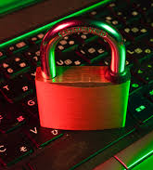
Abstract
In today's world we know the importance of encryption and privacy and with data being the most prized possession it is more important than ever to protect that data. Therefore for our project we are aiming at using this as our principal objective for protecting signal and audio during transmission.
To do this will use digital watermarking and using a digital image/unique code superimposing the signal and then transposing that image as a watermark on the audio signal.
Watermarking is a technique used to label digital media by hiding copyright or other information into the underlying data. The aim is to create a watermark that must be imperceptible or undetectable by the user and should be robust to attacks and other types of distortion. In our method, the watermark is kept as a digital image or if contingency arises a masked signal copy.

Slide 4
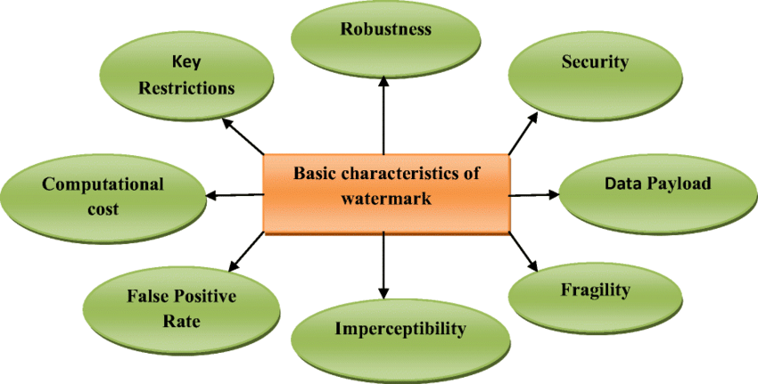
Introduction
Audio watermarking is currently at the forefront of technology development to detect illegal reproduction and redistribution of audio recordings.
Watermarking or Steganography embeds machine readable information like copyright or original information within the underlying data of the signal.
A reliable digital audio watermarking shall have imperceptibility, data capacity, and robustness. The watermark must be inaudible within the host audio to maintain audio quality. The objective of watermark should be to not destroy/alter the data within the signal.
One of the features of Watermark is that it can be copied and carried away with the data and the watermark can be retrieved from the copy and the source of distribution is known.
Therefore for our project we have aimed at a way to protect an audio signal or audio file by encrypting it with a watermark which will ensure that each audio signal transmission and reception is protected from both ends of the communication.

Slide 5
LITERATURE OVERVIEW
PAPER | KEY REMARKS USED
S. E. Tsai and S. M. Yang, An Effective Watermarking Method Based on Energy Averaging in Audio Signals: Hindawi Mathematical Problems in Engineering Volume 2018 | Proposes a spread time echo method by using pseudo noise sequencing for digital watermarking. Uses the phenomenon of repetition of sound on reflection from an obstacle and encrypts it using PRN, also known as pseudo random noise. Uses a signal on the same length as a noise and satisfies it using statistical randomness.
Laurence Boney, Ahmed H. Tewk and Khaled N. Hamdy, Digital Watermarks for Audio Signals, Département Signal, Department of Electrical Engineering, University of Minnesota: Minneapolis, MN 55455, 2019. | Method of focus is PN sequencing Uses sets of bits that are statistically meant to be random. This Approach is an improvement on the previous approach as it depends on a function that can be utilized by any software and can run even on low end systems.
M. Yamini, H.Karmouni, M.Sayyouri, Efficient watermarking algorithm for digital audio/speech signal, Engineering, Systems and Applications Laboratory, National School of Applied Sciences, Sidi Mohamed Ben Abdellah University, BP 72, My Abdallah Avenue Km. 5 Imouzzer Road, Fez, Morocco, 2019. | A blind and audio/speech watermarking algorithm that combines the DC MASKING and discrete wavelet transform (DWT). Although this algorithm is extremely fast and provides a solution for the image compression as well, we voted to not use this as the scope of mathematics required to implement the method is way beyond our scope and will not meet/line up with the deadline of the project.

Slide 6
PAPER | KEY REMARKS USED
F.Benedetto,G.Guinta, A.Neri, Digital audio watermarking for QoS assessment of MP3 music signals, Dept. of Applied Electronics, University of ROMA TRE, Rome, Italy. 2020. | Discusses the type of audio signal that we are aiming at. And at the same time this paper proposes an watermarking signal technique to provide a quality assessment of the received audio signal after coding.
Mohsen Yousefi Nejad, Mohammad Mosleh,A blind quantum audio watermarking based on quantum discrete cosine transform, Department of Computer Engineering, Tabriz Branch, Islamic Azad University, Tabriz, Iran. 2018. | It uses the integration of LSB (least significant bit) and MSB (most significant bit) based on quantum discrete cosine transform (qDCT). Expresses a finite sequence of data points in terms of a sum of cosine functions oscillating at different frequencies.
J. P. Princen, A. W. Johnson und A. B. Bradley: Subband/transform coding using filter bank designs based on time domain aliasing cancellation, IEEE Proc. Intl. Conference on Acoustics, Speech, and Signal Processing (ICASSP), 2161–2164, 1987. | Discrete Wave Transform always returns only a single coefficient to its approximation value. Using the same on a multi level signal allows the extraction of multiple time-frequency features from a time series by decomposing the series as low and high frequency level - by - level. This is also a wonderful approach that does not over complicate the signal transposing value.

Slide 7
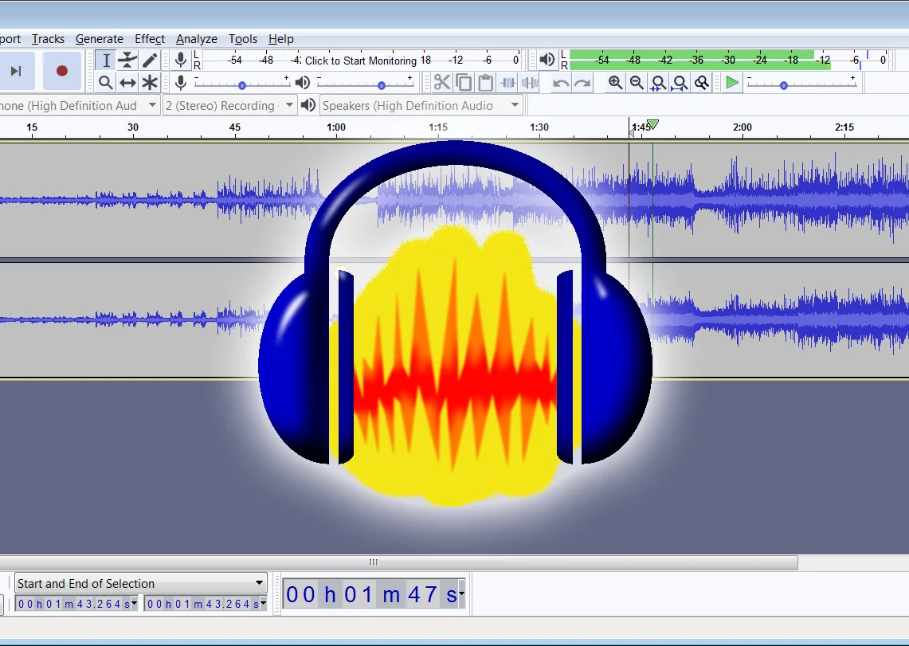
Quality Of Service - Method of Audio Testing
The QoS is known as the quality of services and refers to any technology that deals with data transmission. It is in place to reduce the packet loss, jitters and latency on the network. There are priorities in place that every transmission must follow to abide by these protocols. As applications such as phone, video, and time-sensitive data transit a network, enterprise networks must deliver predictable and quantifiable services.
We used a similar software called Audacity to find out for ourselves whether the theoretical flaws we found were practical or not.

Slide 8

Proposed Methods
Waveform Variation Overlapping Method Digital Watermarking using MATLAB
The audio clip of “The Adventures An extension to previous method, in this a A jpeg image of an aircraft is used to
of Sherlock Homes” was used as single waveform of “Tone” is used rather superimpose on the audio file using
mono stereo track one. The signal but still a noise is being generated MATLAB code to insert it as a
due to which underlying content is not audible watermark on the host file and to extract it
A secondary white noise is added therefore this method is also rejected. At the destination. In this method there is
as track two and a “Tone” signal no noise being generated and the audio
is generated from software. content quality is also maintained.
Since a noise is generated and has
disrupted the audio quality due to
which this method is rejected.

Slide 9
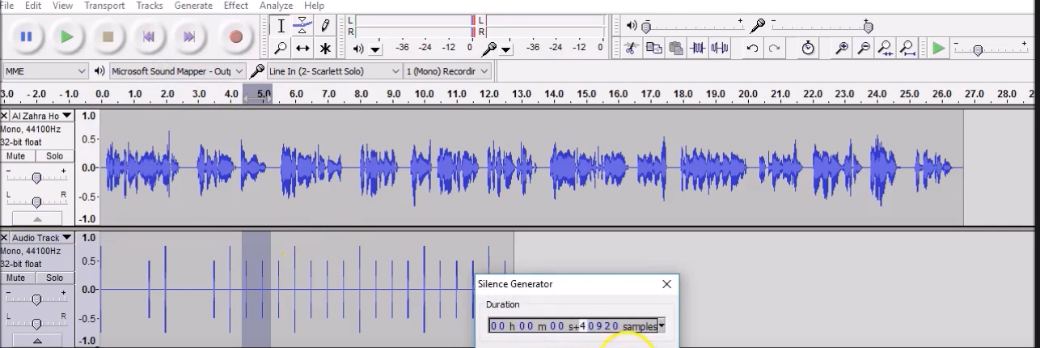
Parameter Name | Value Set
Audio Type | MP3 or WAV
Audio Channel | Mono
Frequency | 44100 Hz
Bit point (floating) | 32 bit
Mapping (range) | - 1.0 - 1.0
Time Sampled | Duration = 60 seconds

Slide 10
Some of the disadvantages of Waveform Variation and Overlapping Method:
We believe that encrypting an audio file like this has several advantages and disadvantages. But in the domain of encrypting an audio signal the disadvantages top the advantages.
The original audio signal will be susceptible to noise.
Anyone with the audio file can easily see the tune used to encrypt the file and remove it using a mediocre level software.
The sender has almost no control over the encryption.
The raw audio signal gets quite messy to discern the original content of the file

Slide 11
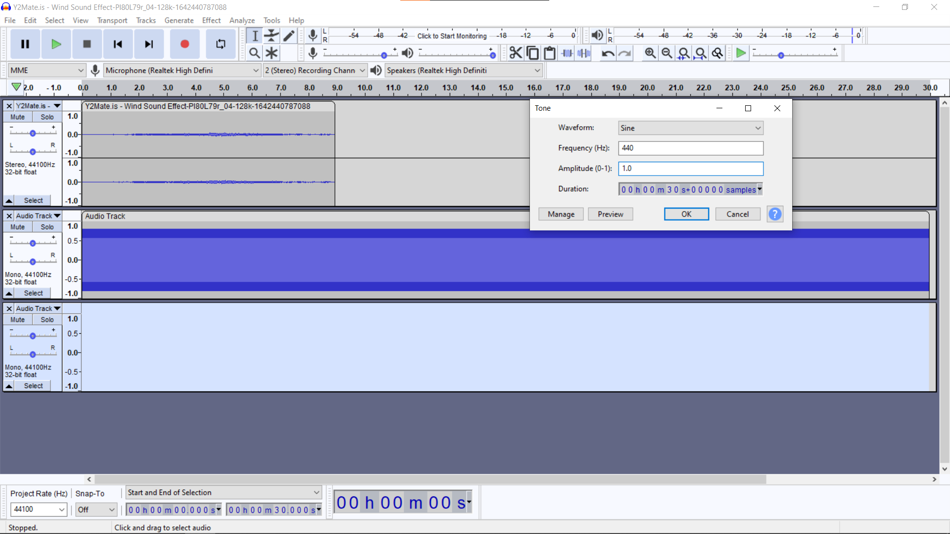
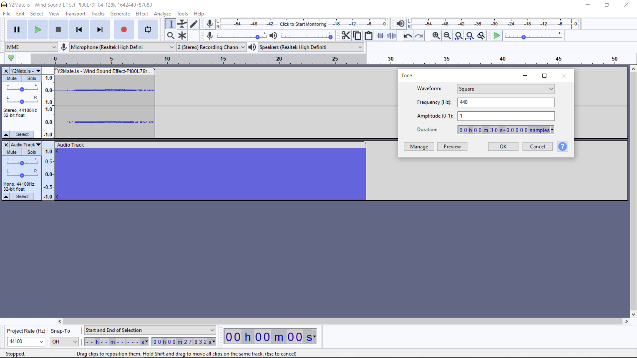
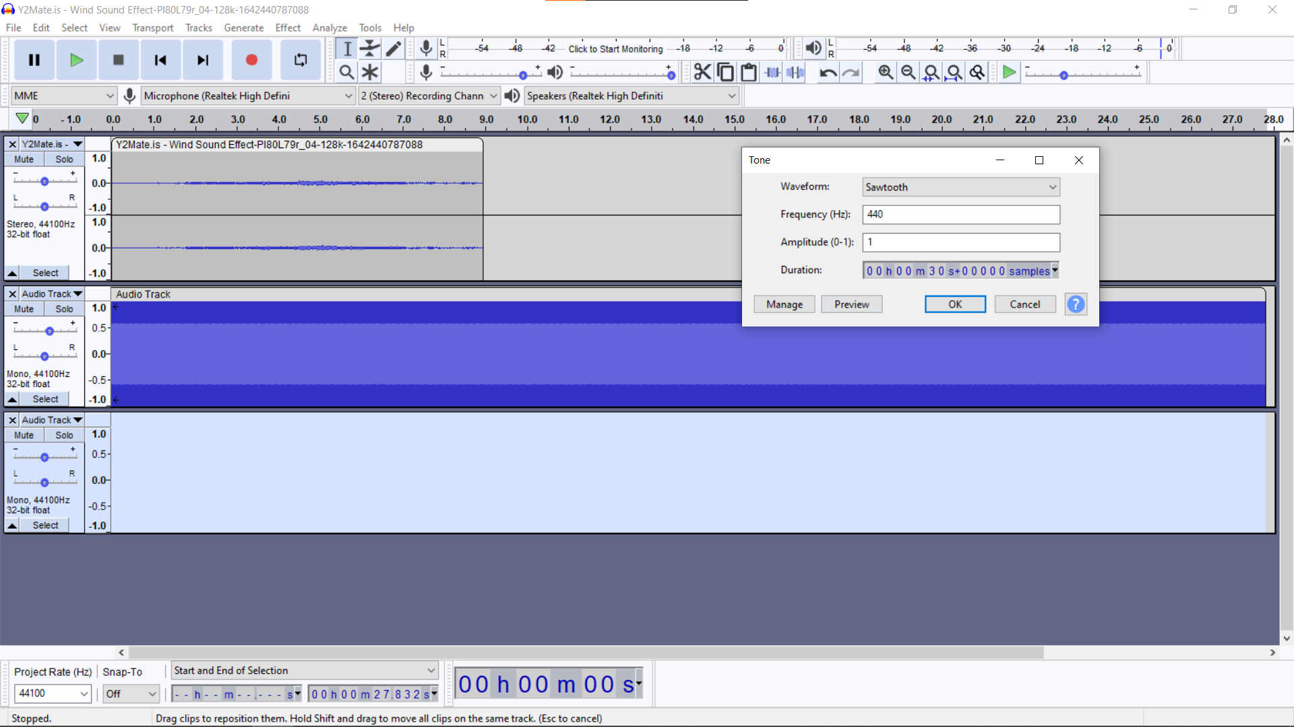
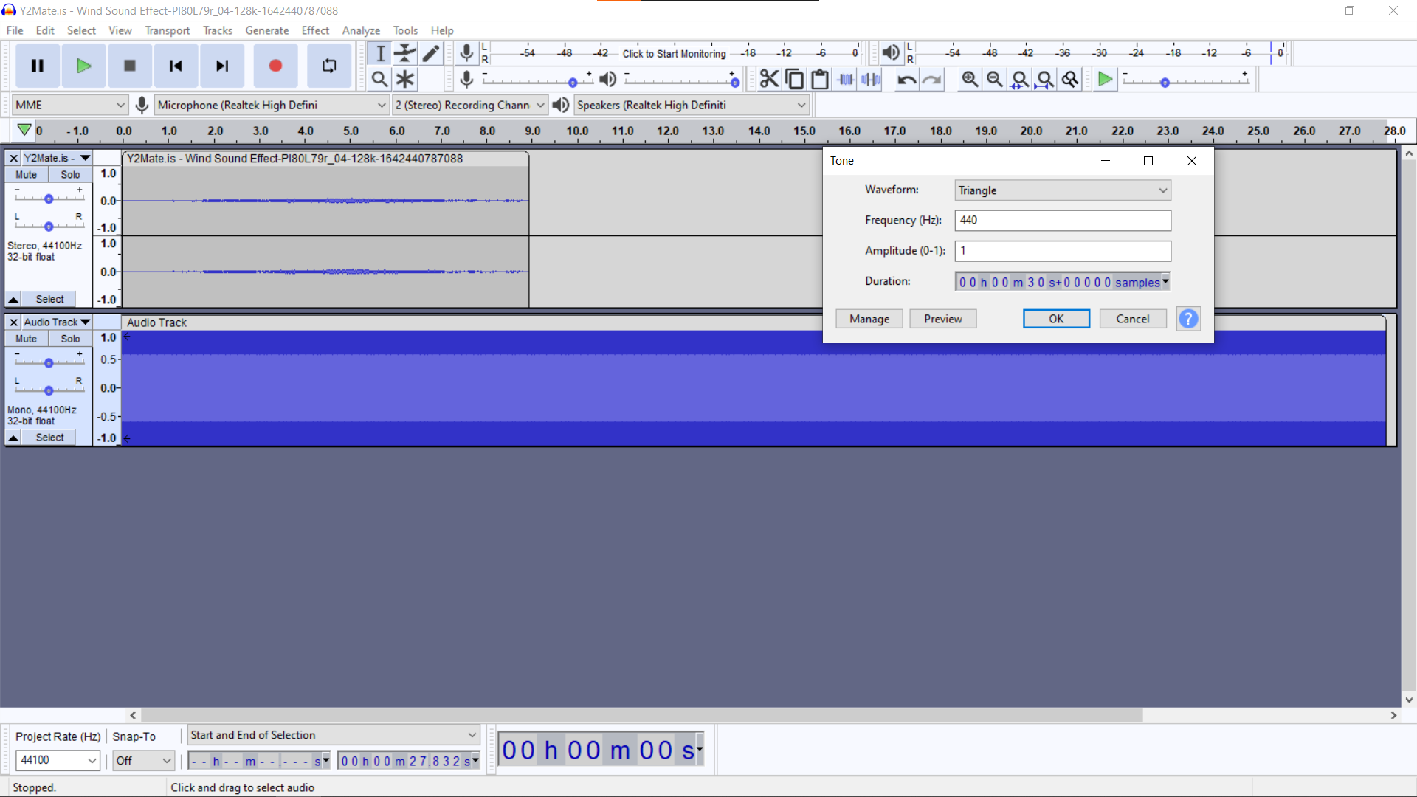
Sine
Square
Sawtooth
Triangle

Slide 12
Algorithm Analysis
Masking Effects
A “weak” sound is difficult to be heard while a “strong” sound is also being played.
Temporal Masking - Amplitude (Volume)
Frequency Masking - Amplitude in Frequency
Image parameters - width="370" height="270“.
DC Watermarking
DC Watermarking puts the information into the part of music, where the magnitude is lower than the perceptual threshold of human ears.
Frequency Watermarking
For Frequency Watermarking, since human ear has limit on distinguishing audio frequency, it is possible to find out a frequency band loud enough while the frequency near it are rather quiet. Therefore, we replace the frequency band with low magnitude to our information to make the watermark.
Process
We implemented Frequency Watermarking in this project to achieve our goal.
The original soundtrack we used in this project is:
Length: 30 seconds
Sampling Rate: 44100 (1/s)
Frame Length: 512 samples

Slide 13
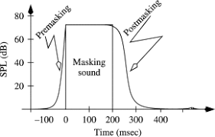
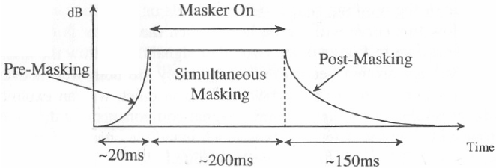
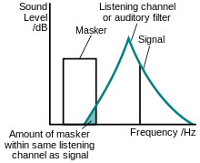
Audio masking is the effect by which a faint but audible sound becomes inaudible in the presence of another louder sound.
Temporal masking whereas is a form of audio masking when a signal and a maker are not present simultaneously. Backward masking is when the maker follows the signal and forward masking is when the signal follows the maker.
Spectral masking (aka transmission masking) causes tones that can be heard in quite to be inaudible over higher spectral content.

Slide 14
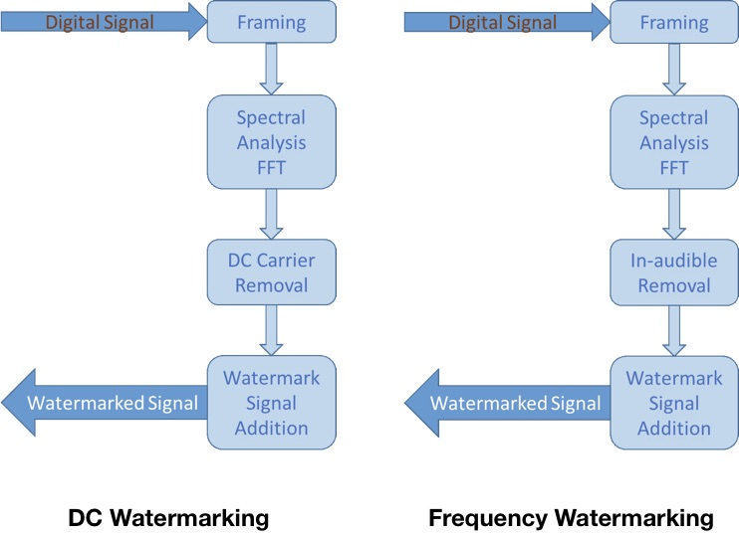
Methodology

Slide 15
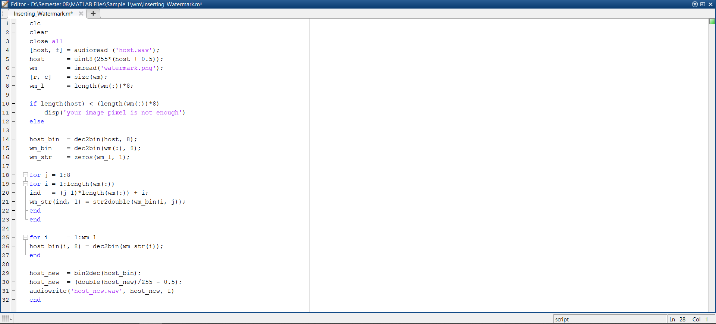
Frontend UI - Watermark Embedding

Slide 16
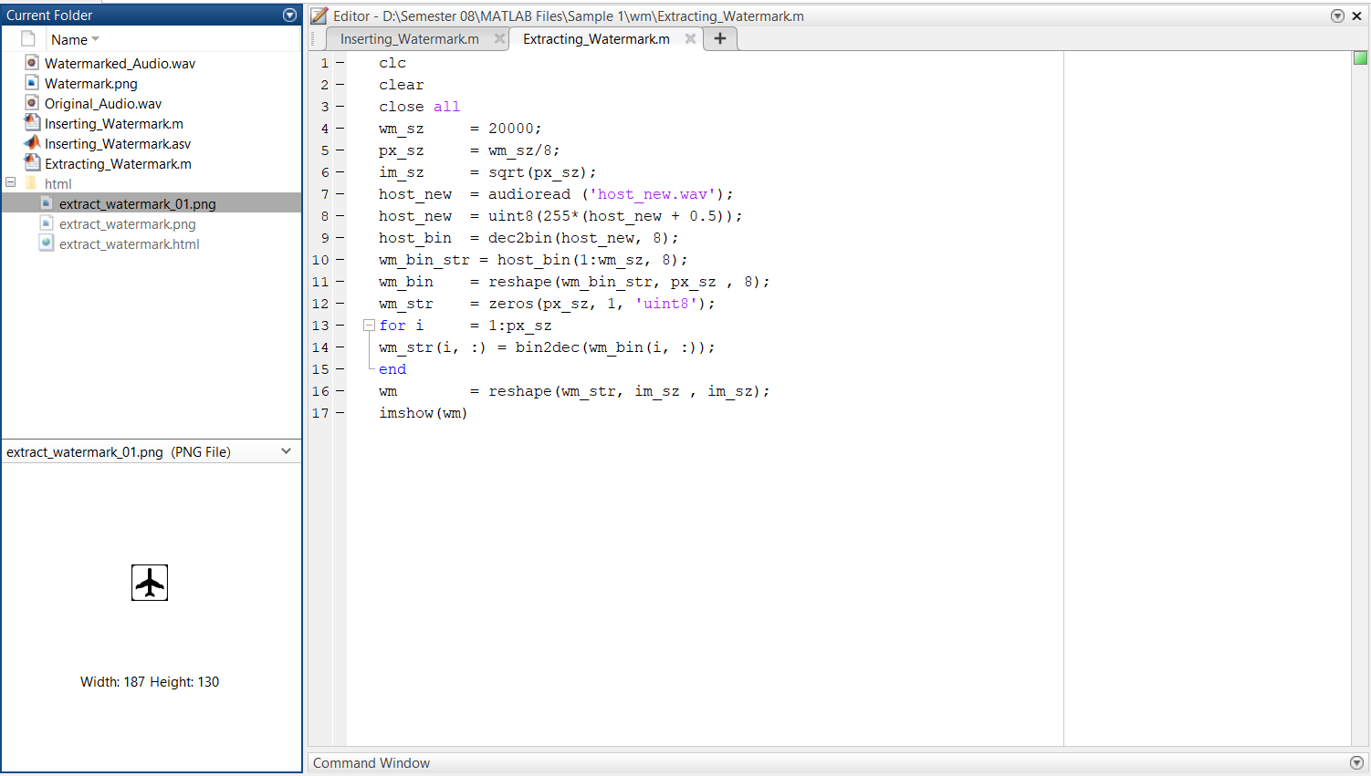
Frontend UI - Watermark Extraction

Slide 17
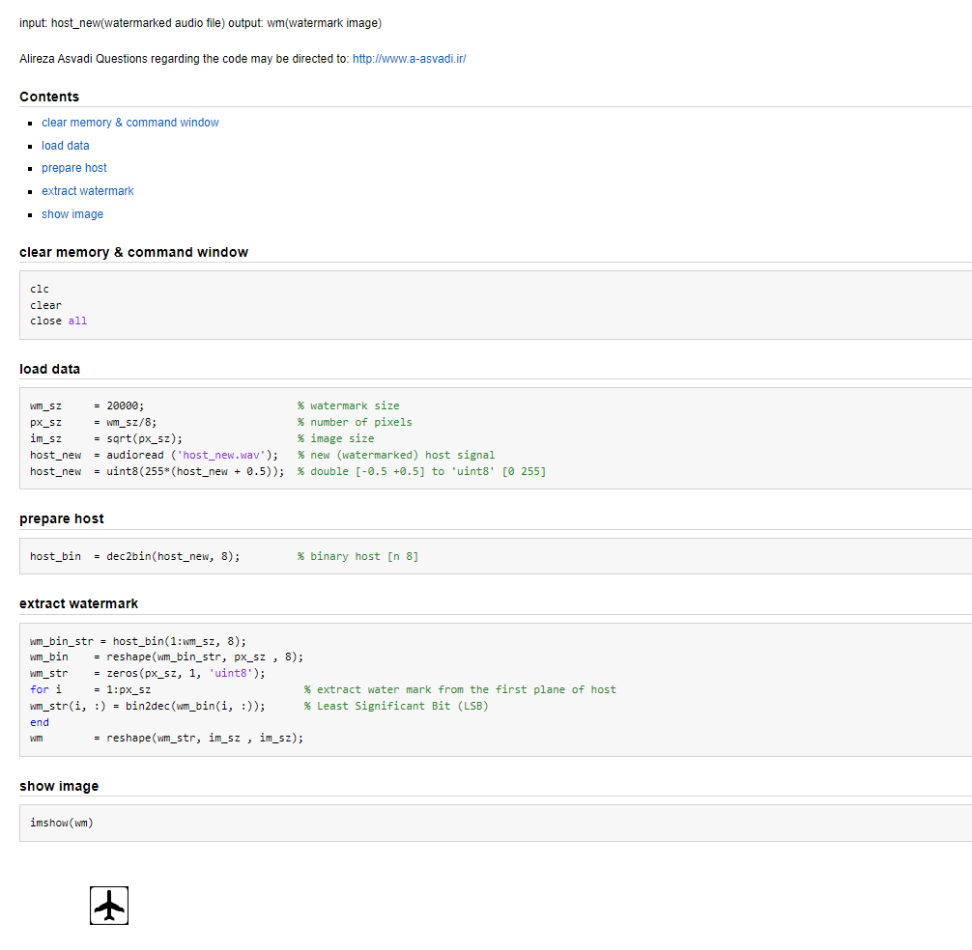
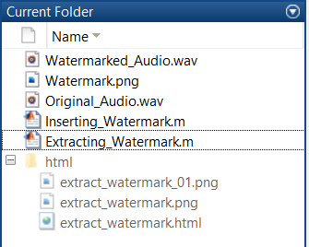

Findings & Inference

Slide 18
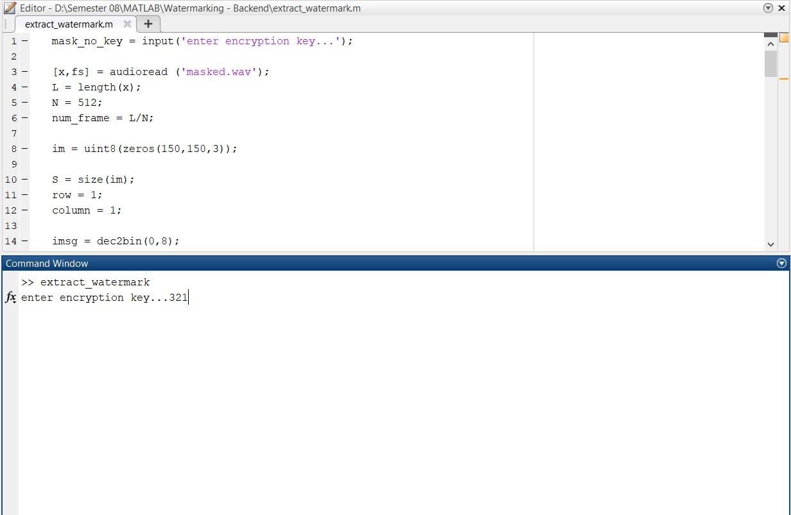

Watermark is resisted to 3rd party breaches
The code itself Is ENCRYPTED…

Slide 19
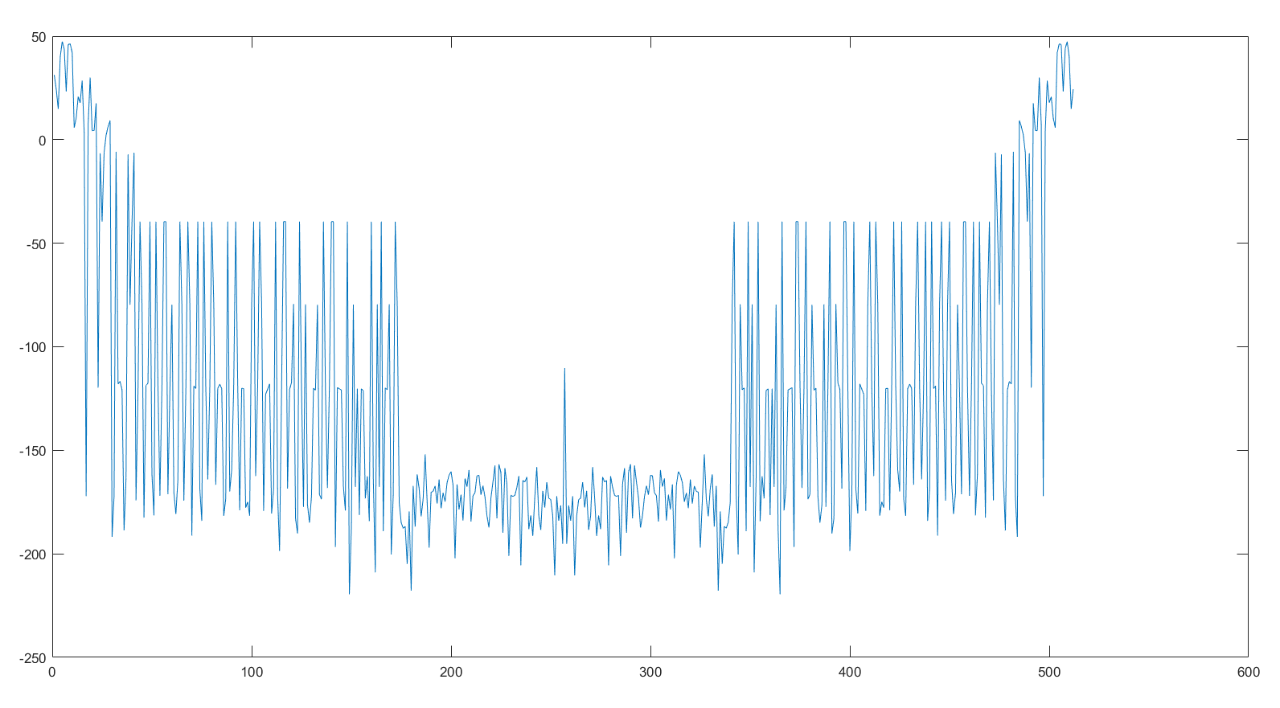
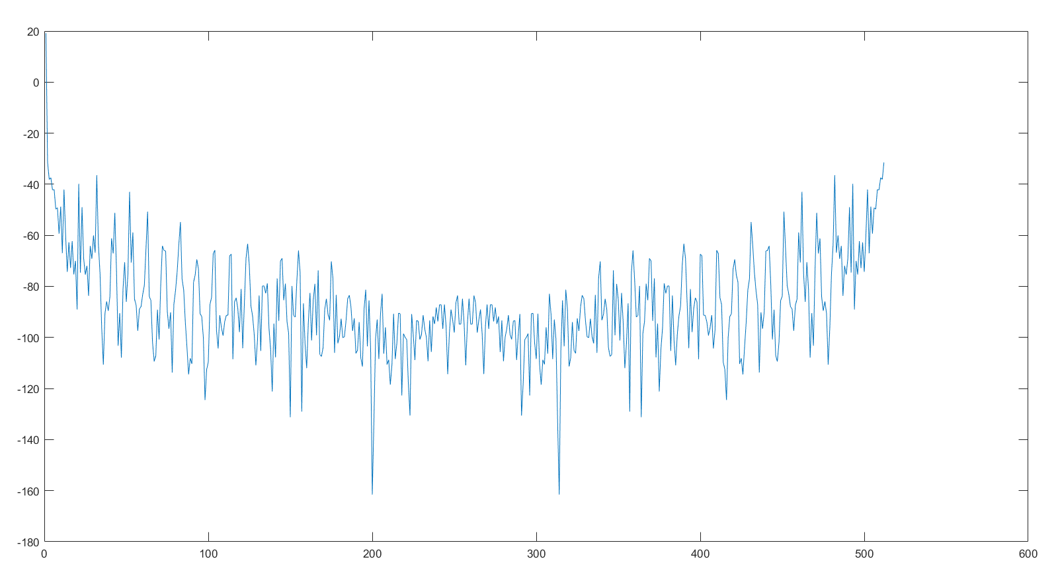
Placement of PRN watermarked image in the audio facilitated by Spectral masking

Slide 20
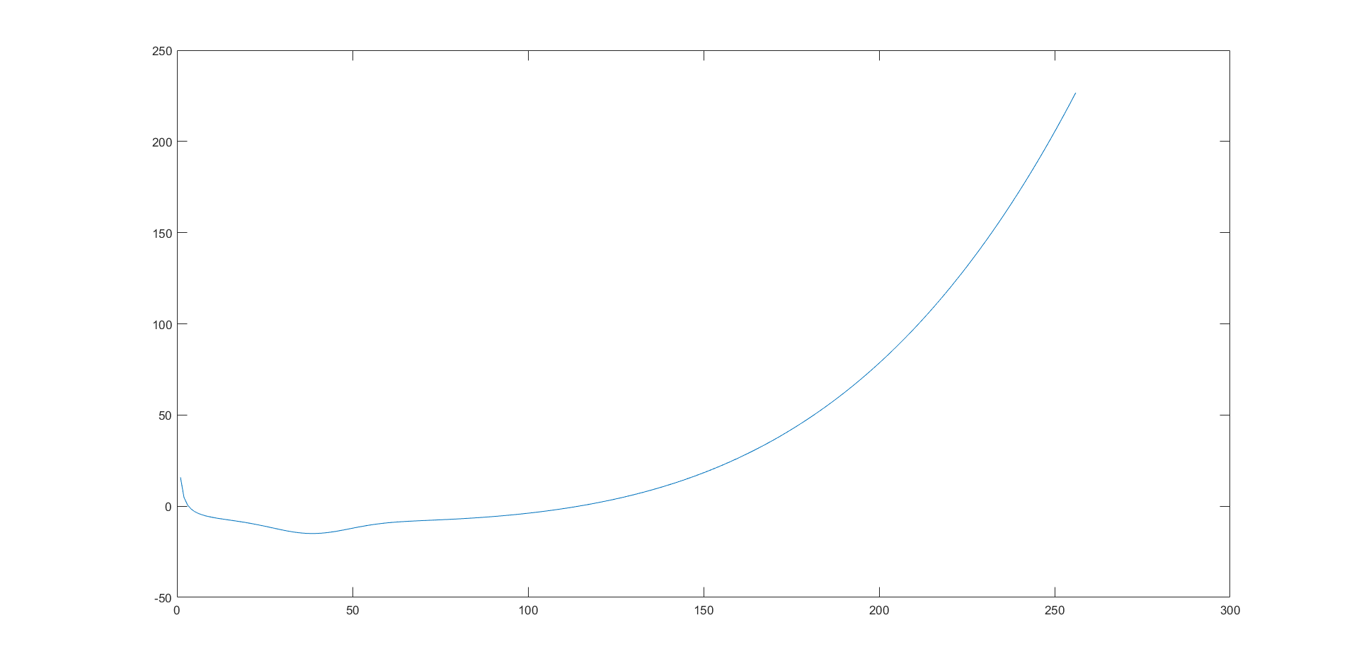
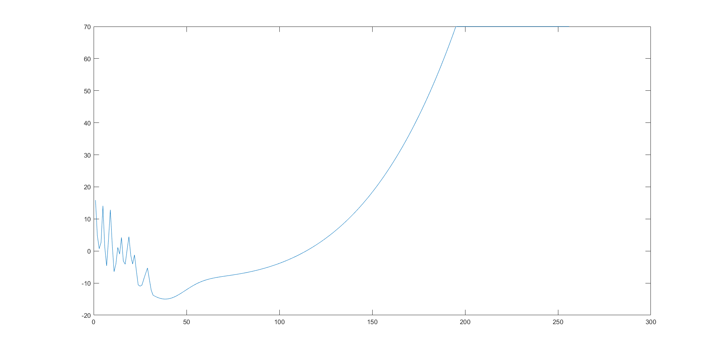
Sample 1
Different watermarks have different spectral graphs post PRN sequencing which makes COPYING the watermark during transmission worthless….
Sample 2

Slide 21
Result
Therefore after analyzing the previous outputs and studying their disadvantages it is observed that using digital watermarking of audio signals for enhanced signal protection is indeed one of the most convenient ways to go about the problem statement of audio encryption.
An inference is drawn that using this form of audio encryption solves all the 4 disadvantages mentioned in the overlapping method of encryption. For starters not anyone who gets the encrypted audio can decode the audio as the sender has the numbers required to decrypt and extract the watermark.
Secondly the sender has total control over the encryption which was not possible in the traditional encryption methods.
And lastly the integrity of the original audio signal stays preserved and does not get out of sync or phase, so if we want to send the audio file to a 3rd party we can do so with the watermarked audio intact.

Slide 22
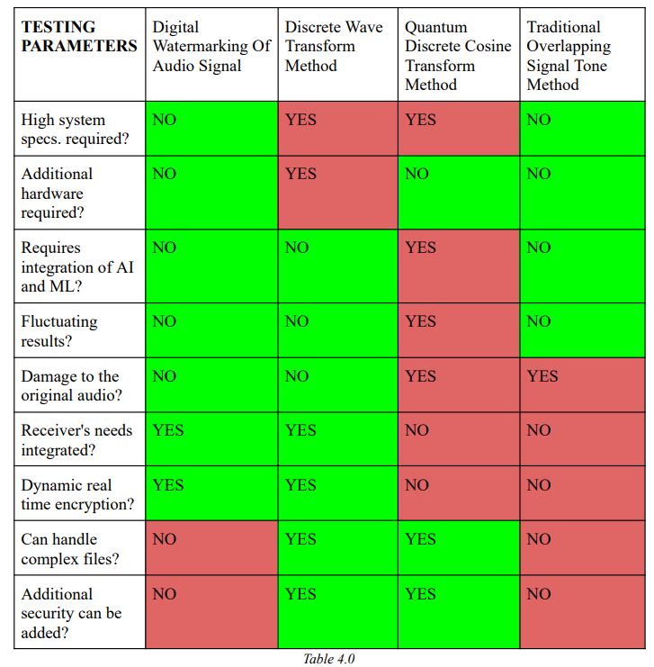
contd…
PARAMETER | EXPECTED | ACTUAL | TESTED ON
ISP Packet Loss | Max 228 Bytes in 5 Seconds | 144 bytes in 10 seconds | https://packetlosstest.com
Latency | 80ms - 100ms | 87ms | https://superpowered.com/weblatency
Delay | 24 Milliseconds | 20 milliseconds | https://packetlosstest.com
Distortion | 7% | 6% | No test available (needs manual monitoring)

Slide 23
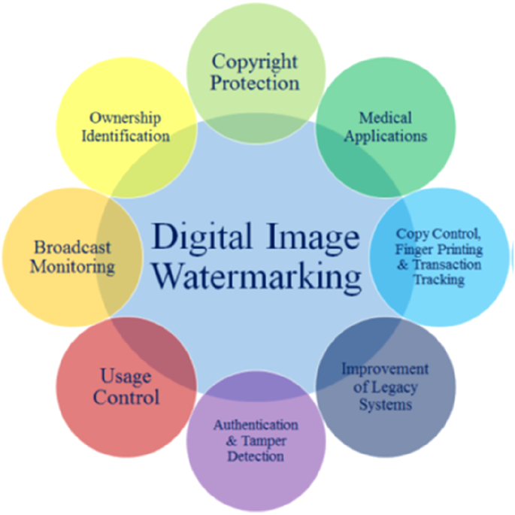
Project Applications
The Digital Watermarking has got a wide range of applications. Some of them are as follows:
Copyright Protection
Source Tracking (different recipients get differently watermarked content)
Broadcast Monitoring
Video Authentication

Slide 24
Work Plan
S .No | Nature Of Work | Schedule | Status
1 | Literature Survey | January 2022 | Completed
2 | Identification of basic Facilities for project. |  | Completed
3 | Audio Classification | February 2022 | Completed
4 | Algorithmic Study |  | Completed
5 | Digital Watermarking | March 2022 | Completed
6 | Backend Hashing Code |  | Completed
7 | Result Enhancement and Fine Tuning |  | Completed

Slide 25
References
Pana, Flavius; Put, Ferdi (December 2014), "Performance evaluation of RSVP using OPNET Modeler", Simulation Modelling Practice and Theory, 49: 85–97,
IPSphere: Enabling Advanced Service Delivery Archived January 13, 2011, at the Wayback Machine
"End-to-end quality of service support over heterogeneous networks". Project description. European Community Research and Development Information Service. Retrieved October 12, 2011.
Torsten Braun; Thomas Staub (2008). End-to-end quality of service over heterogeneous networks. Springer. ISBN 978-3-540-79119-5.
"Multi Service Access Everywhere (MUSE)". Project website. Retrieved October 12, 2011.
"Multi Service Access Everywhere". Project description. European Community Research and Development Information Service. Retrieved October 12, 2011.
M. Davarynejad, S. Sedghi, M. Bahrepour, C.W. Ahn, M. Akbarzadeh, C. A. Coello Coello, "Detecting Hidden Information from Watermarked Signal using Granulation Based Fitness Approximation", Applications of Soft Computing: From Theory to Praxis, Springer, Series: Advances in Intelligent and Soft Computing, Volume 58/2009, ISBN 463–472, 2009.
M. Davarynejad, C.W. Ahn, J. Vrancken, J. van den Berg, C .A. Coello Coello, "Evolutionary hidden information detection by granulation-based fitness approximation", Applied Soft Computing, Vol. 10(3), pp. 719–729, 2010.

